Slide 1





In association with Dept of CSE
wHACKiest'24
<Urban Development>
<Connectify>
Code Catalysts
Anirudh Agarwal (1MS24EI022-T) Jeevika N (1MS24CS186-T)
Sai Deepak Akuthota(1MS24CS117-T) Anusha Agarwal(1MS24CS095-T)
wHACKiest </2024> Idea Submission

Slide 2

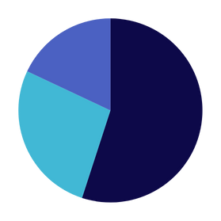
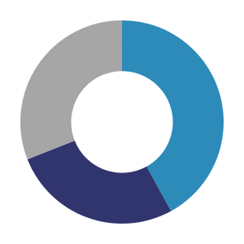



Problem Statement
In rapidly growing urban areas, social isolation and lack of meaningful connections among residents are significant challenges. While cities provide numerous opportunities for shared living, fitness, and events, individuals often struggle to find compatible companions for cohabitation, exercising, or attending local activities. This disconnect not only affects personal well-being but also undermines the sense of community essential for sustainable urban development.
SURVEY INSIGHTS
18%
LNeed for flatmates as per various filter preferences
Need partner for sports to find motivation
Not willing to attend social events because of lack of partner
27%
55%
Survey Link: https://forms.gle/faLUtUD4wdFcZ8EU8
TOP PAIN POINTS
Weak social ties reduce opportunities for collaborative living and shared experiences, key aspects of building cohesive urban communities
31%
Likely to attend social events because of lack of partner
Struggle to go to Gym because of lack of partner
Looking for flatmates as per preference
40%
A platform that connects individuals based on shared goals, interests, and compatibility can foster stronger social bonds.
27%
Existing social and event apps focus more on networking or entertainment but fail to address deeper, everyday connections.
wHACKiest </2024> Idea Submission

Slide 3
Proposed Idea
Our Target
Connect
Personalise
Collaborate
Approaching Urban Harmony
Why Us?
A platform that connects individuals based on shared goals and interests fosters meaningful social bonds, reinforcing technology's role in building inclusive and connected urban communities.
Consolidate:Bringing people together in one platform to share common interests and participate
Encouraging shared activities like cohabitation, gym partnerships, and event participation promotes healthier lifestyles and vibrant urban living.
Personalisation:Lets you apply your filters based on your preferences
Empower urban residents to connect meaningfully, creating communities that are socially integrated, healthier, and more sustainable.
AI-powered Suggestions: Utilise AI to Suggest Preferences based on location
ABOUT YOU
FIND
YOUR
PARTNER
Sign Up
SOCIAL LINKS
CONNECT
REJOICE
wHACKiest </2024> Idea Submission

Slide 4


TECH STACK
Frontend (User Interface)
Tech Stack: React.js with Tailwind CSS
Why React.js?
Component-based architecture: Makes it easy to build reusable UI components.
Fast rendering: Uses a virtual DOM for optimized performance.
Large ecosystem: Popular and widely supported by libraries and tools.
Rich interactivity: Suitable for real-time updates and dynamic matching features.
Backend (Server Logic & APIs)
Tech Stack: Node.js with Express.js
Why Node.js?
Non-blocking, event-driven model: Perfect for real-time features like matching, messaging, or notifications.
Unified JavaScript stack: Allows the same language on both frontend and backend, simplifying development.
Large community and libraries: Speeds up development with ready-made modules.
Database (Data Storage)
Tech Stack: PostgreSQL (Relational Database)
wHACKiest </2024> Idea Submission

Slide 5
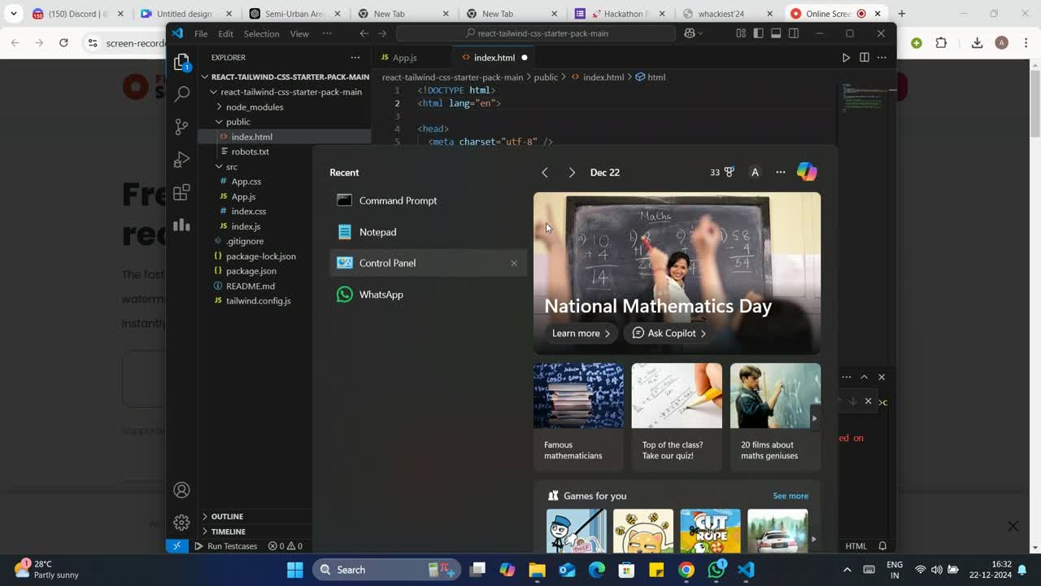

Slide 6
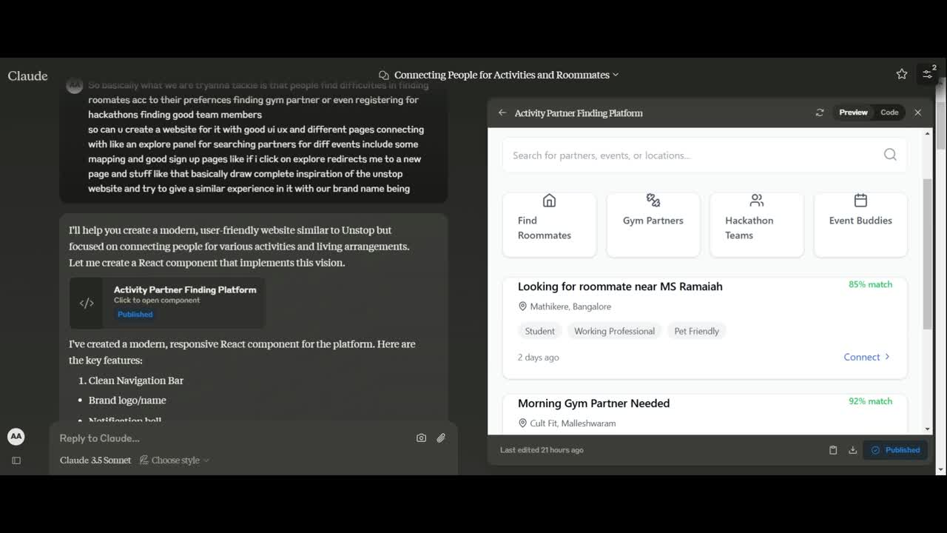

Slide 7
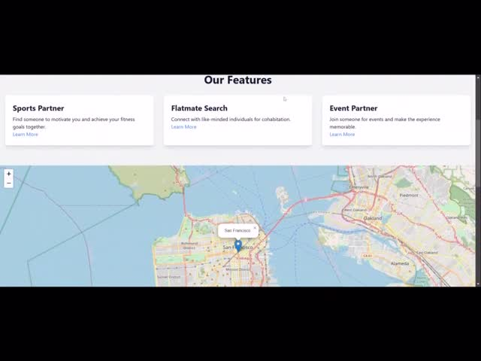

Slide 8

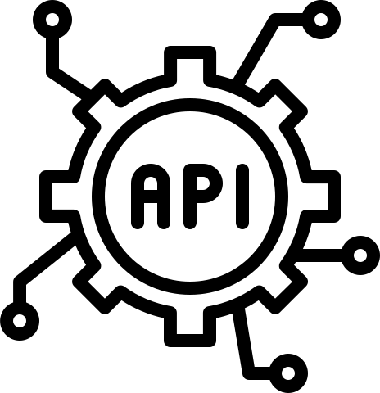



FlowChart
CLIENT LAYER
Mobile Apps
Web Apps
API Gateway
DATA ARCHITECTURE
Auth Service
Google Map API
Razorpay API Gateway
Real-Time Updates
User profile changes are instantly reflected across the platform
Desktop Apps
Filter based Search
Lets you filter your preferences
Activity Tracking
User actions are logged for reference and analysis
SECURITY ARCHITECTURE
User Authentication
Verifies user identity through secure login methods
AI/ML Insights
Predictive analysis is used to offer personalized recommendations
Data Encryption
Protects sensitive data using advanced encryption techniques.
Access Control
Restricts access to data and features based on user roles.
DEPLOYMENT ARCHITECTURE
Compliance & Auditing
Ensures adherence to regulations and tracks system activities for audits.
CI/CD Pipeline
Code is automatically tested for errors before deployment
TECHNICAL ARCHITECTURE
Incident Response
Implements strategies for detecting and responding to security breaches.
Load Balancers
Distribute traffic evenly to ensure high availability
Frontend
(React.js/Angular.js)
Backend
(Node.js/Express)
Monitoring & Alerts
Real-time monitoring with error and dip alerts enables quick fixes
Middleware
(Kafka/RabbitMQ)
Database
(PostgreSQL/MySQL)
wHACKiest </2024> Idea Submission

Slide 9



Conclusion
Enhanced Partnership preferences:This is problem solving solution for urban job seekers or students to look for flatmates who match their preferences.
Improved participation in social events:This is a great solution to find partners for attending events be it college activities or a social gathering
Building a like-minded Community:This solution will enhance fostering a lcommunity of like-minded individuals to take part in activities
wHACKiest </2024> Idea Submission

Slide 10



Why this Idea?
Participate in events and activities in your area.
Use online tools to connect with others who have moved away from their hometowns.
Reach out to friends and family in the same area.
Academic Opportunities, Gaining broad perspective and cultural understanding, taking up new opportunities or just for the purpose of getting out of your comfort zone – these are some of the reasons why many people choose to move away from home. As per the Census 2011 data on migration, close to 45 crore people currently do not live in their place of birth.
While moving to a new place might be an experience you look forward to optimistically, one of the main matter which the people are worried are about being able to connect with others. In a new place, everyone is a stranger. In order to form new friendships, people have to connect with others that they have not yet met. This can be intimidating, as individuals may fear rejection or feel uncertain about how they will be perceived by others.
Through social networks and messaging applications, it is possible to establish friendships with individuals who share common interests. This cultural diversity enriches one's experiences and perspective. Connecting with positive and supportive individuals can uplift our mood and combat feelings of loneliness and isolation. Interacting with people from diverse backgrounds exposes us to different viewpoints and experiences, broadening our horizons. It also helps us to develop and redefine our communication, listening and social.
skills.
wHACKiest </2024> Idea Submission

Slide 11
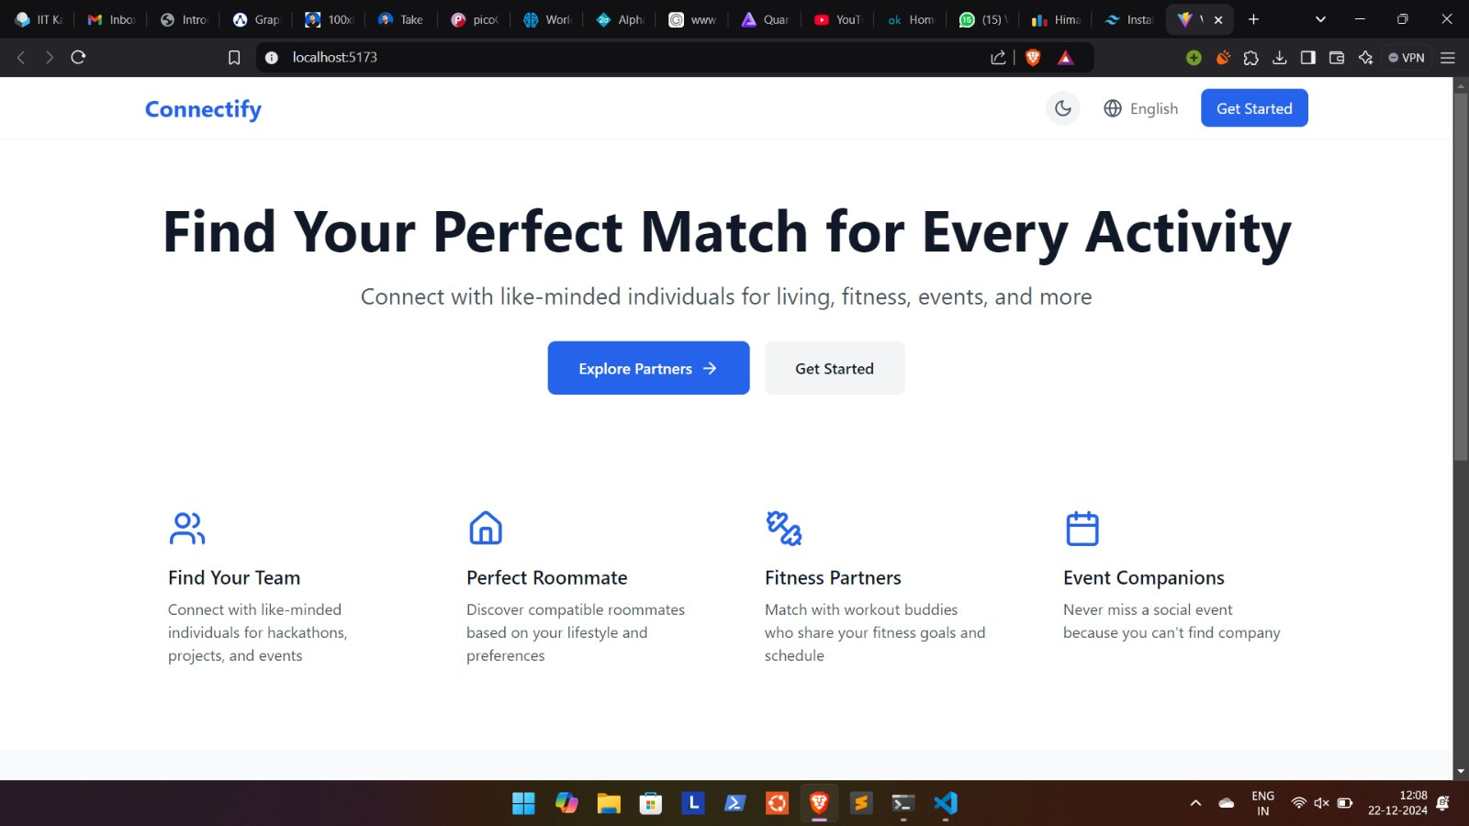

Slide 12
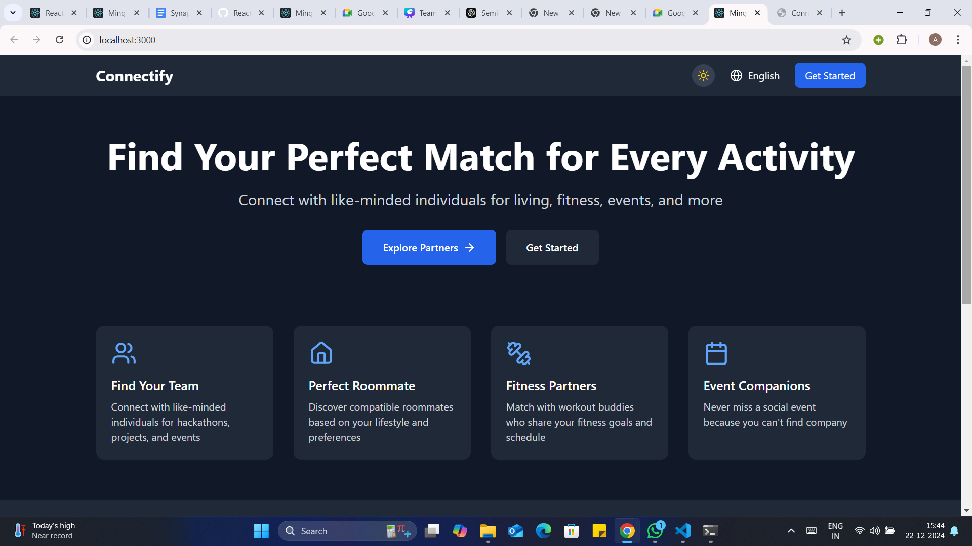

Slide 13
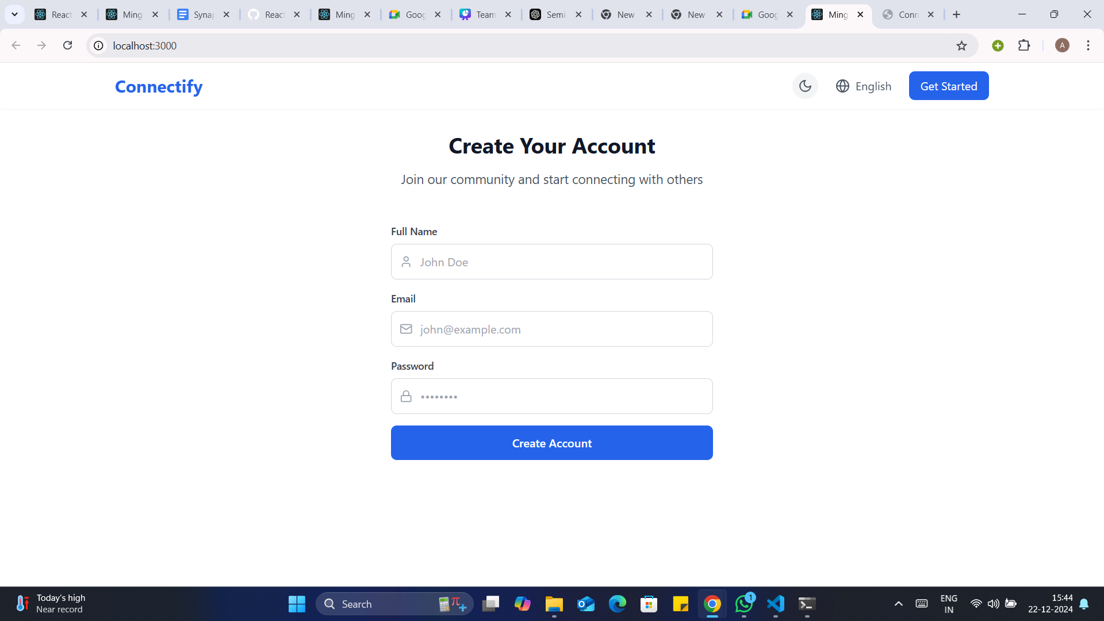

Slide 14
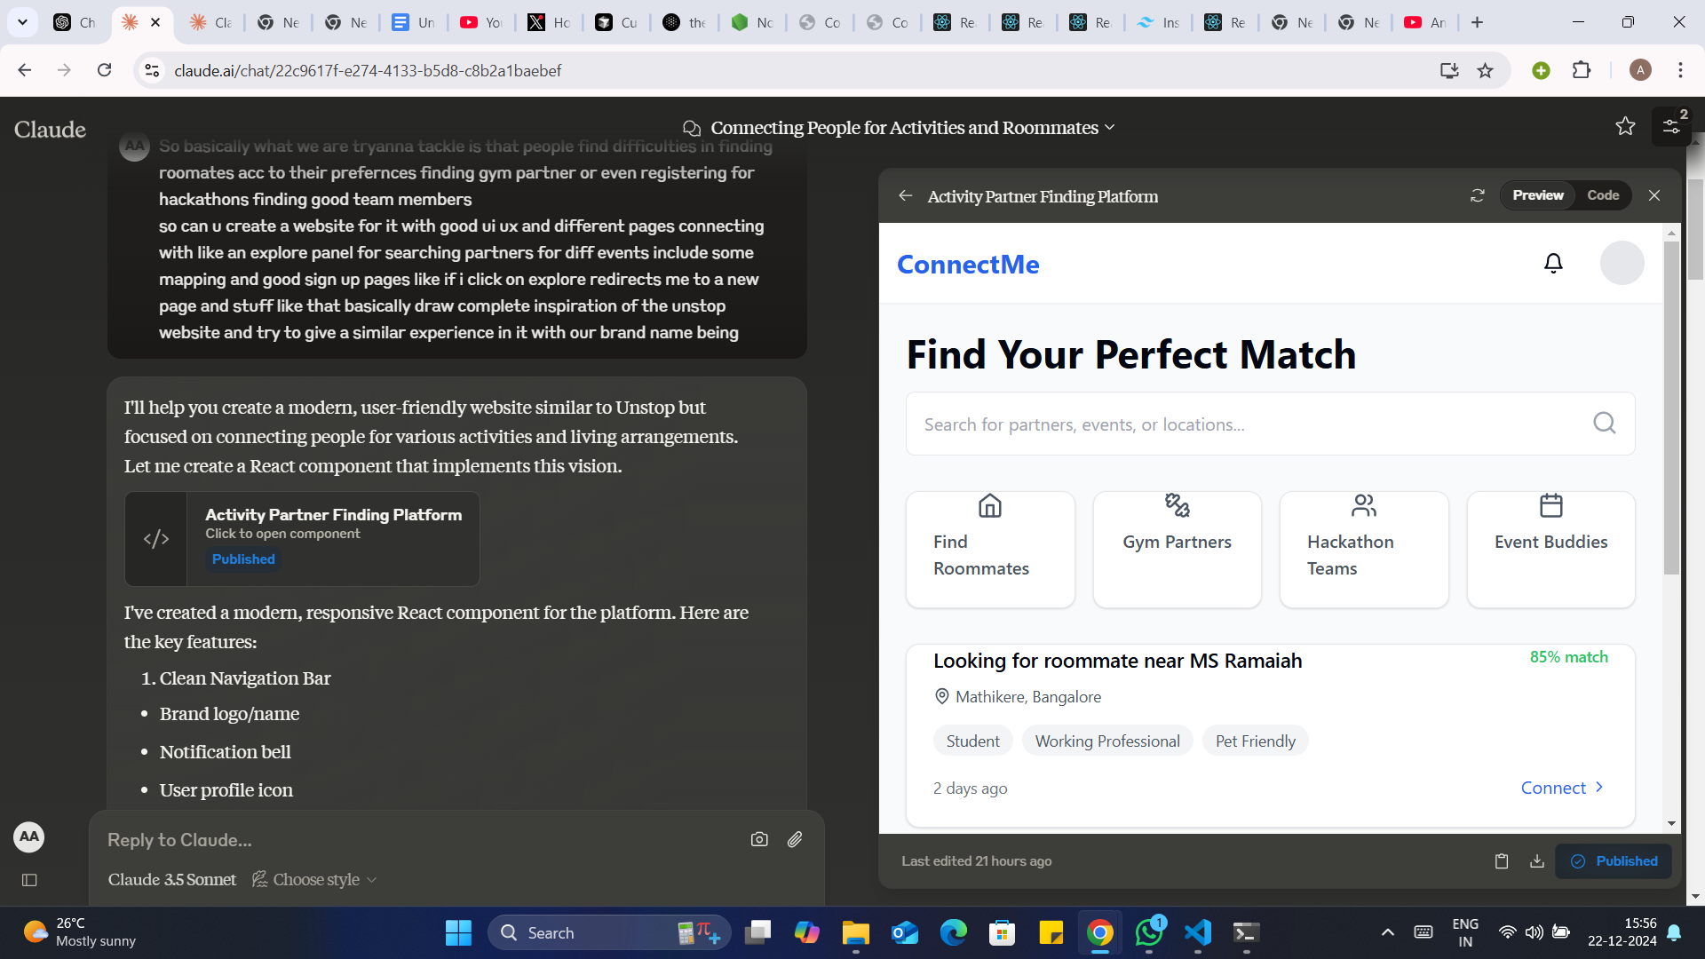
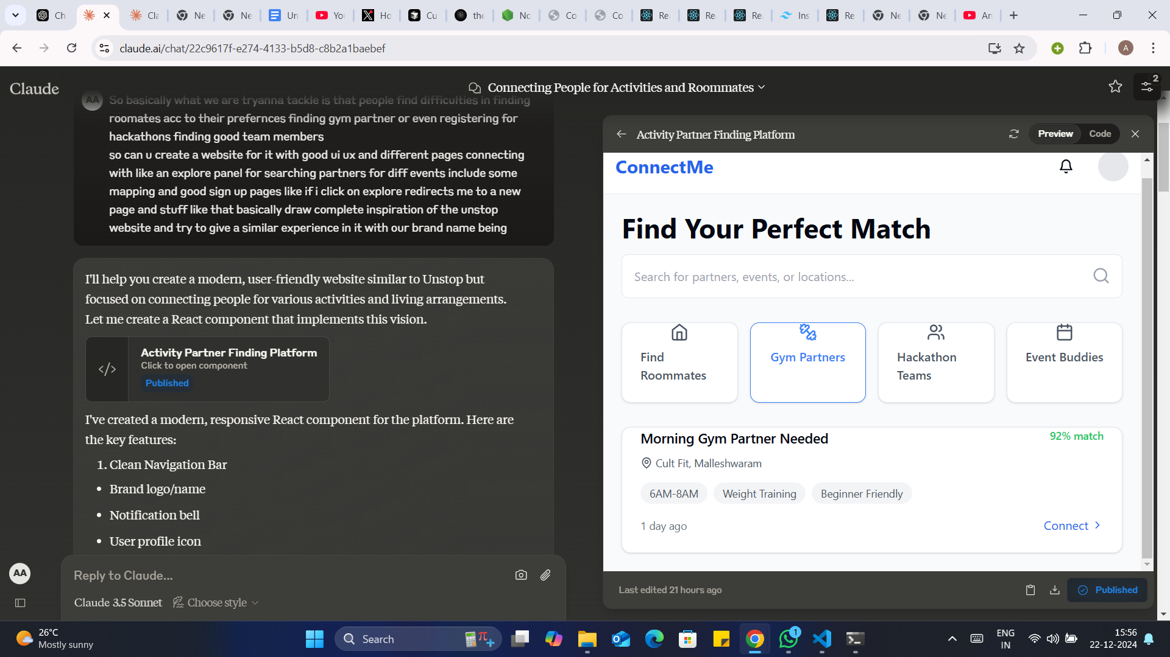
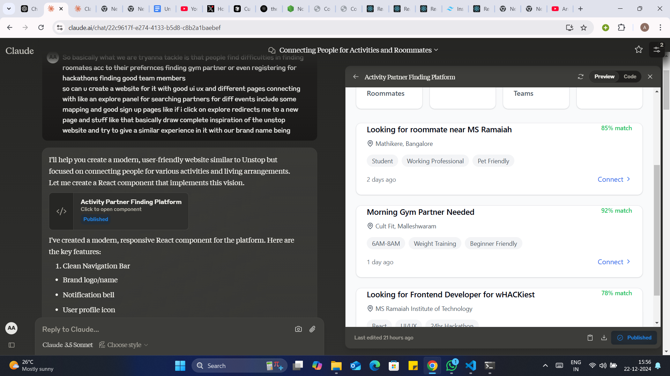

Slide 15
Connectify is a social platform designed to connect people with similar interests and needs in urban cities. Whether you're looking for a gym partner, a fellow event-goer, a sports buddy, or even a flatmate, Connectify helps you find like-minded individuals. The platform aims to make it easier for people to meet others who share their passions and lifestyle, fostering a sense of community and connection.
Features
Connect with Like-minded People: Find individuals who share similar interests, whether it’s sports, fitness, events, or hobbies.
Event Partnerships: Meet people who are interested in attending the same events and activities in urban cities.
Sports and Gym Buddies: Connect with others who are into the same fitness activities and sports.
Find a Flatmate: Looking for someone to share a flat in a bustling city?Connectify helps you find potential flatmates who match your lifestyle.
User Profiles: Customize your profile, including age, interests, location, and more.
Matching System: Use an intelligent matching algorithm to find the best matches based on interests and preferences.
Tech Stack
Frontend:
HTML: Used to structure the content on the web pages.
CSS: Styling the frontend to create an engaging and responsive design.
JavaScript: Adds interactivity to the pages, such as form validation, animations, etc.
React: The framework used for building the user interface, providing a dynamic and fast user experience.
Backend:
Python: Used to handle the backend logic, including user management, matchmaking, and data processing.
SQL: Structured query language for database management and storage of user data, including interests, location, and other preferences.

Slide 16
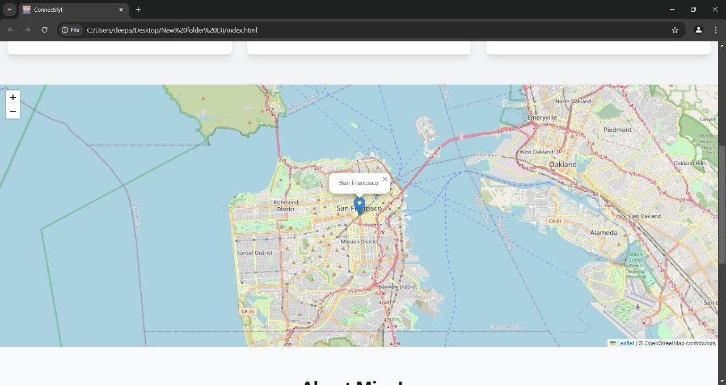

Slide 17
THANK YOU!
wHACKiest </2024> Idea Submission

